Slide 1
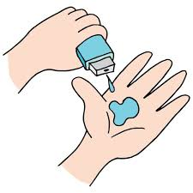
Project Title - Seasonal Agriculture Performance Analysis
Student Name – Thakur Anisha
College Name - Jawaharlal Nehru
Technological University Hyderabad
AICTE STU ID : STU682ca0c0595581747755200

Slide 2

PROBLEM STATEMENT
Agricultural performance varies across different seasons due to changes in environmental conditions, resource availability, farming practices and economic factors.
Agricultural activities are influenced by seasonal variations in environmental conditions, farming practices, resource availability and market conditions. As a result, agricultural performance may differ from one season to another.
However, raw agricultural data does not clearly explain how agricultural performance changes across seasons or what patterns can be observed in different seasonal conditions.
The problem is to analyze the given agricultural dataset and investigate seasonal differences in agricultural performance by identifying meaningful patterns, trends, relationships and variations within the available data.

Slide 3
Project Description ->Seasonal Agriculture Performance Analysis is a data analytics project that examines agricultural activities across different seasons and geographical areas. ->The dataset contains information about:
Crops and agricultural seasons
Farm area and geographical locations
Rainfall, temperature and humidity
Soil pH and soil moisture
Fertilizer and pesticide usage
Irrigation methods
Crop yield and production
Market price, revenue, cost and profit
Water usage and water efficiency
Disease and pest risk

Slide 4

WHO ARE THE END USERS?
👨‍🌾 Farmers
Select suitable crops and seasons
Improve resource utilization
Understand profitability
🏛️ Agricultural Planners
Support seasonal planning
Identify regional patterns
Improve resource allocation
🔬 Agricultural Researchers
Study environmental and crop relationships
Analyze seasonal trends
💧 Irrigation & Resource Managers
Improve water utilization
Compare irrigation practices
🏢 Government & Policy Makers
Support evidence-based agricultural policies
Identify areas requiring intervention

Slide 5

Technology Used
🐍 Python
Used as the main programming
language for data analysis.
🐼 Pandas
Used for:
->Reading CSV files
->Data manipulation
->Data cleaning
->Grouping and analysis
🔢 NumPy
Used for numerical operations
and calculations.
📈 Matplotlib
Used for creating graphs and visualizations.
📊 Seaborn
Used for statistical visualizations such as:
->Count plots
->Box plots
->Heatmaps
->Scatter plots
☁️ Google Colab
Used as the cloud-based environment for writing and executing Python code.

Slide 6
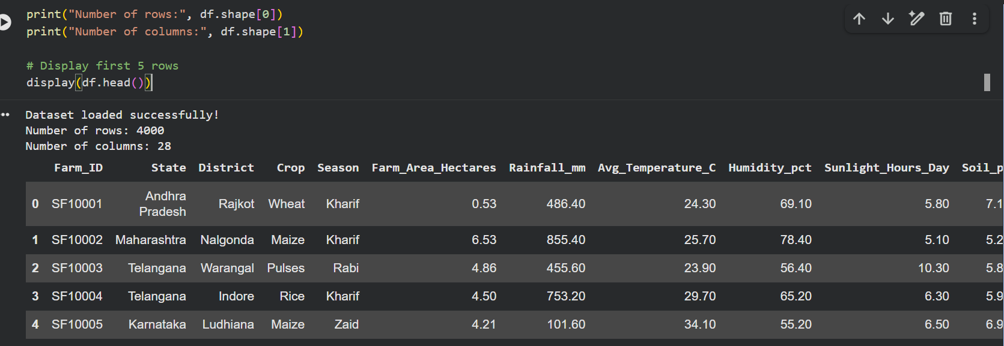
RESULTS
[Add screen shots of your code ]

Slide 7
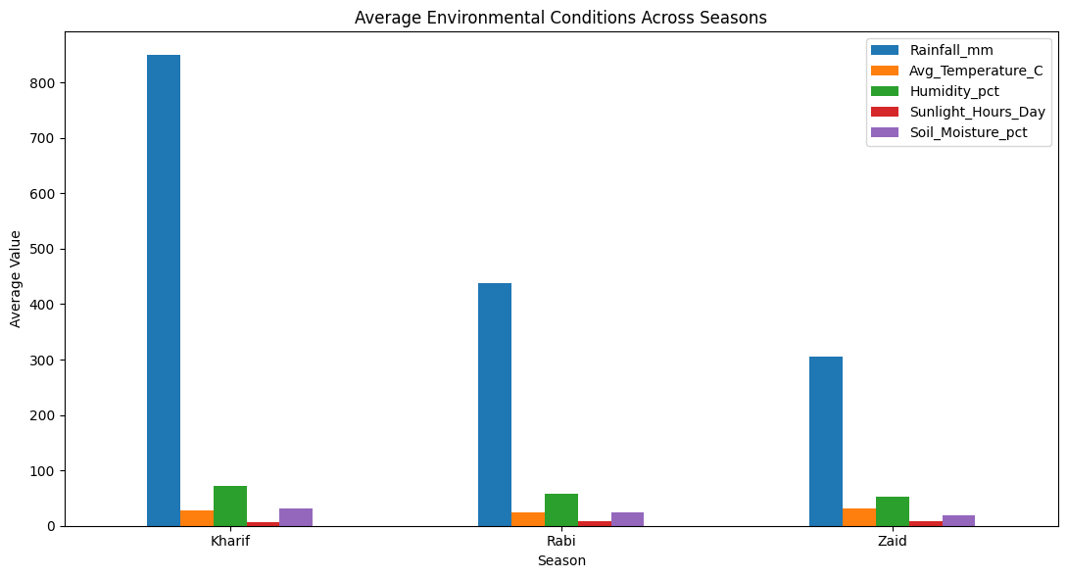
RESULTS

Slide 8
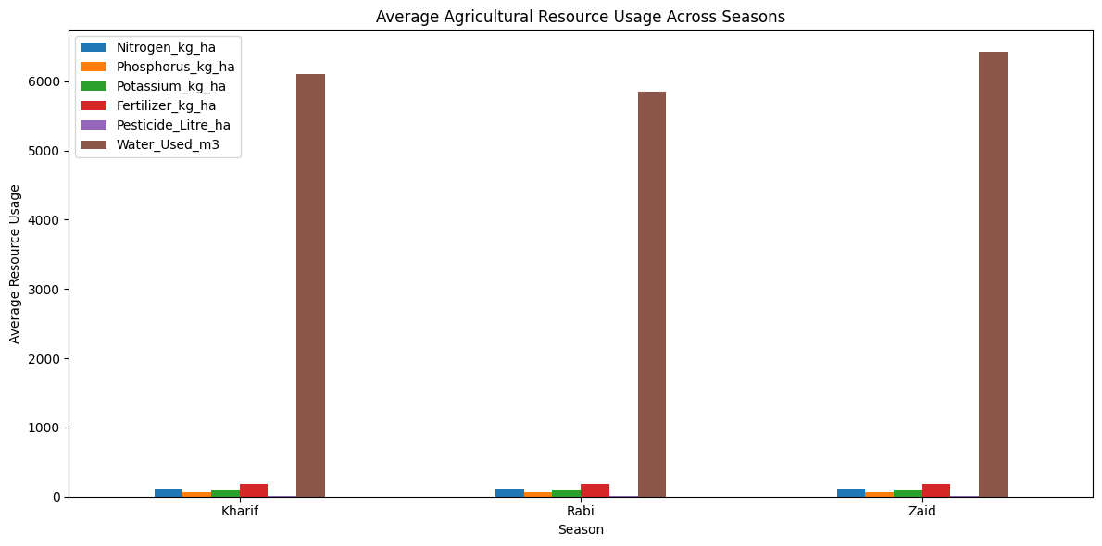
RESULTS
[Add screen shots of your code ]

Slide 9
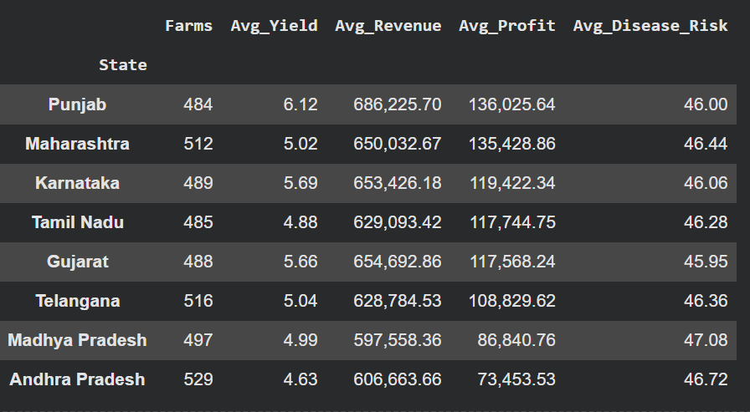
RESULTS
STATE-WISE AGRICULTURAL PERFORMANCE

Slide 10
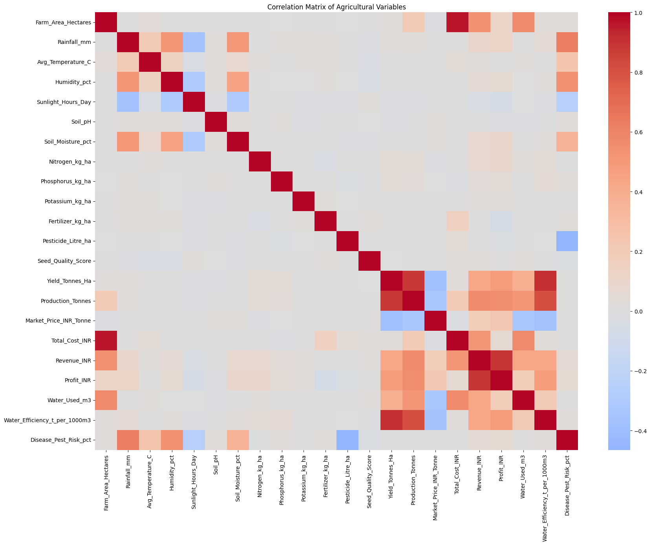
RESULTS
[Add screen shots of your code ]

Slide 11
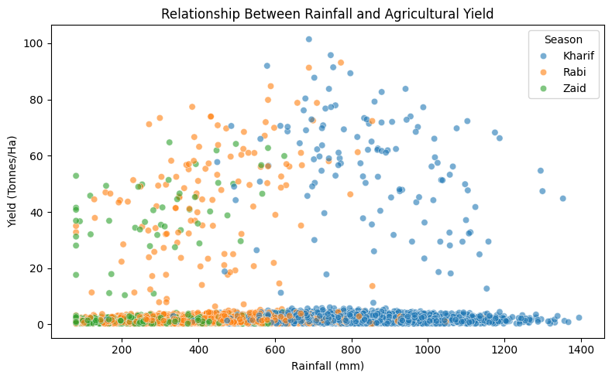
RESULTS
[Add screen shots of your code ]

Slide 12
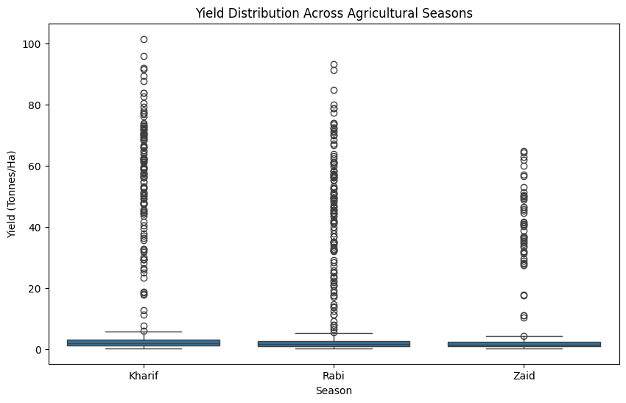
RESULTS
[Add screen shots of your code ]

Slide 13
Future scope
The project can be extended in the following ways:
🤖 1. Machine Learning
Develop predictive models for:
Crop yield prediction
Profit prediction
Disease/pest risk prediction
🌦️ 2. Weather Integration
Integrate real-time weather and historical climate data.
🗺️ 3. Geographic Analysis
Use GIS/maps to identify high-performing and low-performing regions.
💧 4. Smart Irrigation
Develop recommendations for efficient irrigation and water management.
📱 5. Farmer Dashboard
Create an interactive dashboard where
farmers can view:
Seasonal performance
Crop recommendations
Profitability
Water efficiency
📊 6. Real-Time Monitoring
Integrate IoT sensors for:
Soil moisture
Temperature
Humidity
Water usage

Slide 14
GitHub Link
https://github.com/ThakurAnisha/seasonal-agriculture-performance-analysis.git

Slide 15
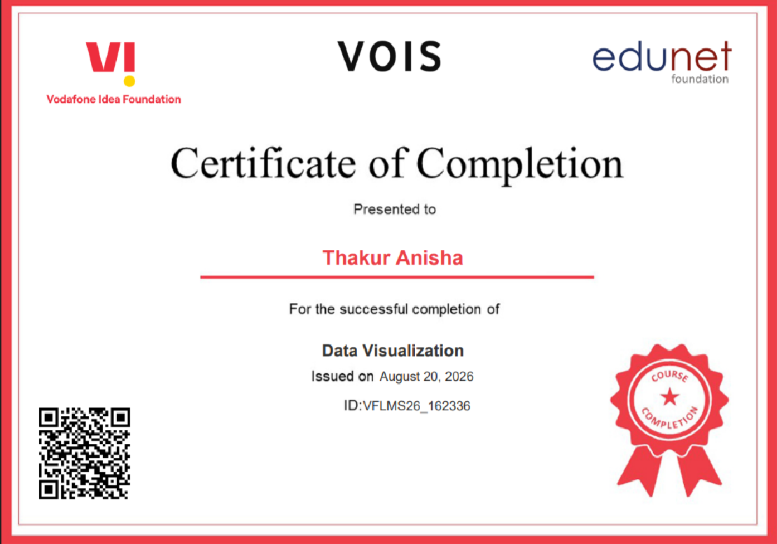
VOIS Course completion certificate - Course name- Data Visualization

Slide 16
Thank you
.
.

